Slide 1
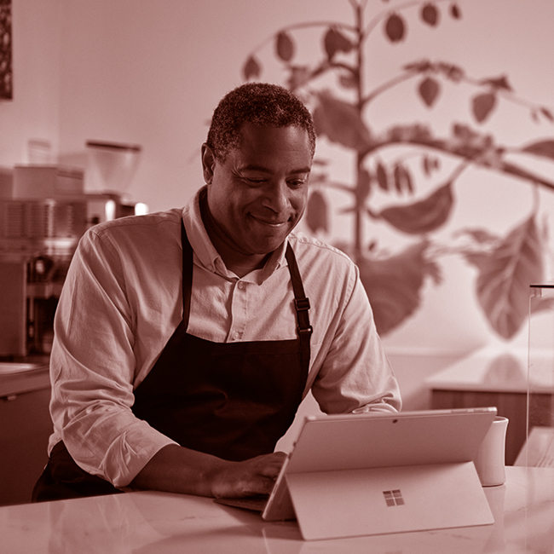



Great relationships start here
Microsoft Advertising
Notes:
Ask a client question like:
What kind of changes are you making to your digital strategy due to the pandemic?
How are you adapting to the changing consumer behavior due to the pandemic?
Who are you finding to be your best customers and has that changed due to the pandemic?
At Microsoft Advertising, we are seeing shifts in peoples' preferences and behavior that are creating long-lasting, permanent changes to how they engage with brands. There are new behaviors emerging that are changing the customer journey as work and life become more blended and people are getting more done online.

Slide 2
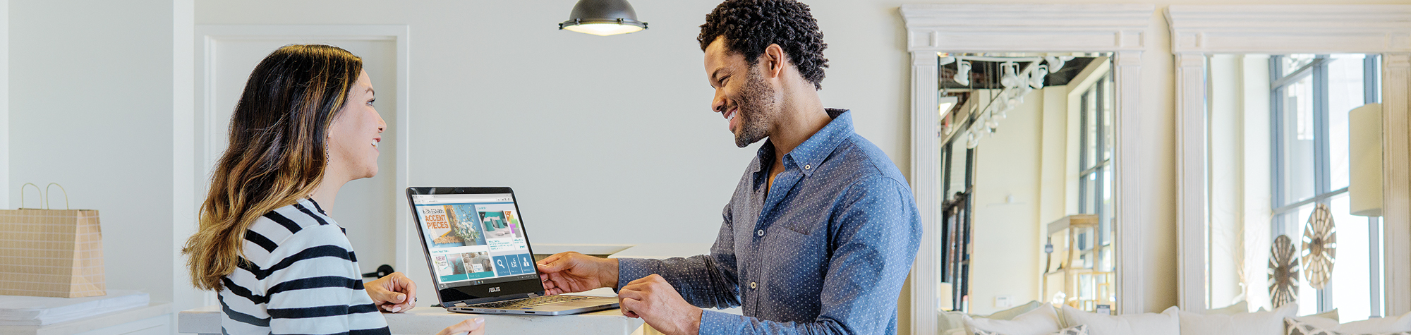
Consumer preferences have changed
Increased demand for personalized online experiences
Contactless shopping and self-checkout options
Switching brand loyalty
Last-mile delivery
Notes:
When we look at consumers, they simply expect more from the brands they know and love (and the ones they don’t know and love) and rapidly technology is becoming a driving factor for a successful retail experience. That said, consumer preferences and behaviors rapidly evolved based on what’s happening in the world with COVID and other global concerns.
Personalization
In our increasingly digital world, the internet is just a proxy for what really matters — getting to know your customers. 78% of U.S. internet users said personally relevant content from brands increases their purchase intent (Source: Marketing Insider Group). Personalization is a given for today’s consumers.
Switching brand loyalty
During COVID-19, many consumers switched brands and retailers with about half expected to continue after the crisis (McKinsey.) And according to ZDNet research, e-commerce adoption will continue to grow after safe store openings with not just Millennials and Gen Z consumers but a majority of older shoppers, including 57% of baby boomers. How then does your offline/online mix match-up to consumer expectations and how do you manage delivery and returns seamlessly?
Contactless
During the peak of the pandemic, consumers sought to limit contact creating a frictionless experience. That resulted in 74 percent of consumers buying additional groceries online (McKinsey Report) and 21 percent spent more overall. According to Mastercard research – 79% of consumers are using contactless shopping and 30% of consumers intend to increase use of self-check-outs post crisis. A new bar has been set for customer experience and what consumers expectations of good service is.
The right message at the right moment is the next level in customer service — it can quickly and easily turn intent into action. People are constantly looking for product information, deals, local availability and local discounts online.
----------------------------------------------------------------------
ZDNet article https://www.zdnet.com/article/covid-19-has-permanently-changed-shopping-behavior/

Slide 3
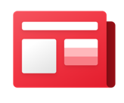



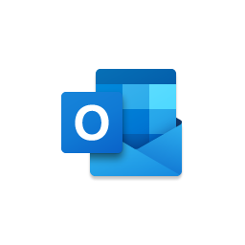

Microsoft Advertising connects marketers with people at the right moments across work and life
Microsoft News
Microsoft Edge
Microsoft Outlook
Microsoft Bing
Notes:
Microsoft services are places where people are getting things done and are in a productivity mindset. This means that they are ready to take action. Having a partner that puts you in front of this audience, as they transition across work and life, translates into audience value that is meaningful to your business. At Microsoft Advertising, we reach your customers when they browse, email and search.
% of user overlap between Microsoft’s properties and Bing: 70% Microsoft News, 48% Outlook, 73% Edge. (Source: comScore Media Matrix, Cross-Visiting Monthly Shared Audience, Total Audience, December 2020, US, Properties: Microsoft News, Bing Web, Outlook Web)
Consider this, a woman is finishing her work calls and needs to quickly find and send a gift for her niece – her birthday being just a few days away. She is on her Windows PC and action-oriented. Before she even can get to Google – which requires her to open a web browser and either type in a query or go to their website – you could have already had 2-3 touch points with her. Microsoft consumer services are integrated into the Windows OS – such as Bing in the taskbar and Microsoft News on the Edge default tab - and offer powerful paths for brands to connect people.
And it’s only through Microsoft Advertising that you can get exclusive placements at these intersectional moments, such as search on the Windows tool bar, or native through Edge tab, as people are shopping and browsing the web.
Microsoft Advertising reaches audiences across work and life with two networks

Slide 4



Our vision is to deepen your customer relationships
RELEVANT REACH TO ONLINE SHOPPERS
Reach new and existing shoppers who are closer to making a purchase and are in the comparison and transaction stages of the consumer decision journey.
RICH EXPERIENCES AND FEED-BASED SOLUTIONS
Showcase your products, prices and more to help increase your click-through rate (CTR) and qualified leads through Product Ads, Multimedia Ads and Microsoft Audience Ads.
TRUSTED AND OPEN DIGITAL PLATFORM
Connect with audiences and build trust. The trust consumers have in brand-safe spaces translates into greater willingness to try and transact with your brand.
Notes:
Why Microsoft Advertising for retail?
At Microsoft Advertising we’re developing new ad types to engage millions of shoppers not found on Google. Solutions that showcase your inventory, provide a richer experience for your customers, and turn clicks into conversion. Solutions that help you scale by accepting the feeds and syntaxes you are already working with.
One thing is clear: doing things the old way is no longer an option. Growing your business requires a new way of thinking about how to reach people when, where, and how they want to engage. It requires accelerating your digital strategy to deliver authentic brand experiences.
Across Microsoft devices and services that people rely on every day across work and life, you gain access to a diverse, global, high-value audience of over 1 billion people. And we deliver audience intelligence that helps you pinpoint your ideal customer and deliver more relevant messages based on audience intent across the entire customer journey.
It’s not just about connecting with audiences. It’s also about building trust. The trust consumers have in brand-safe spaces translates into greater willingness to try and transact with your brand.
Our approach to partnership is about providing multi-channel solutions that allow you to leverage your most valuable assets like your data to improve your bottom line — not ours.

Slide 5
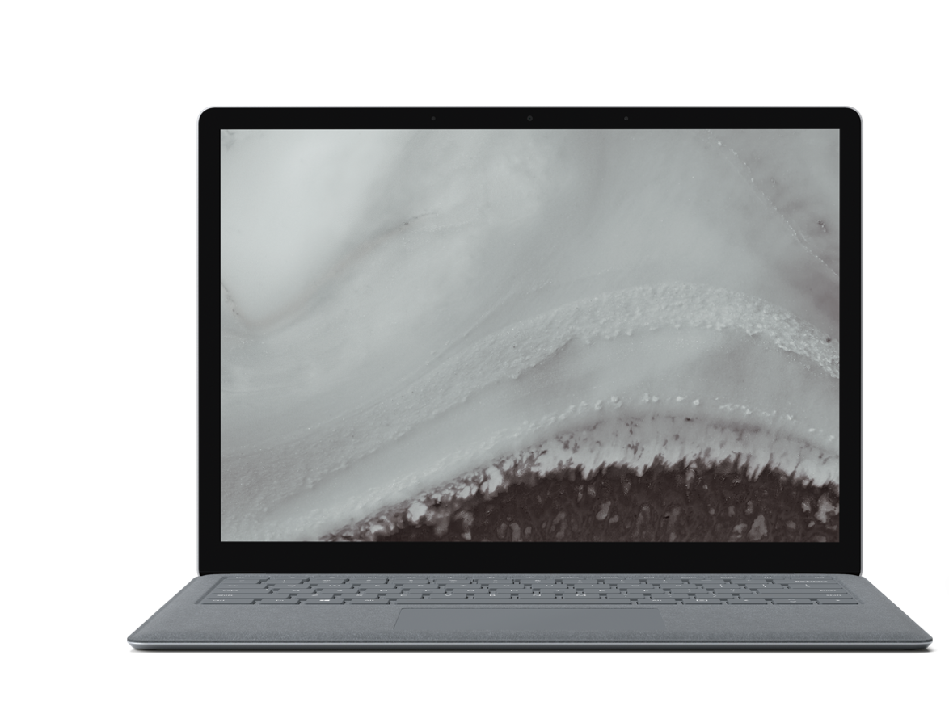
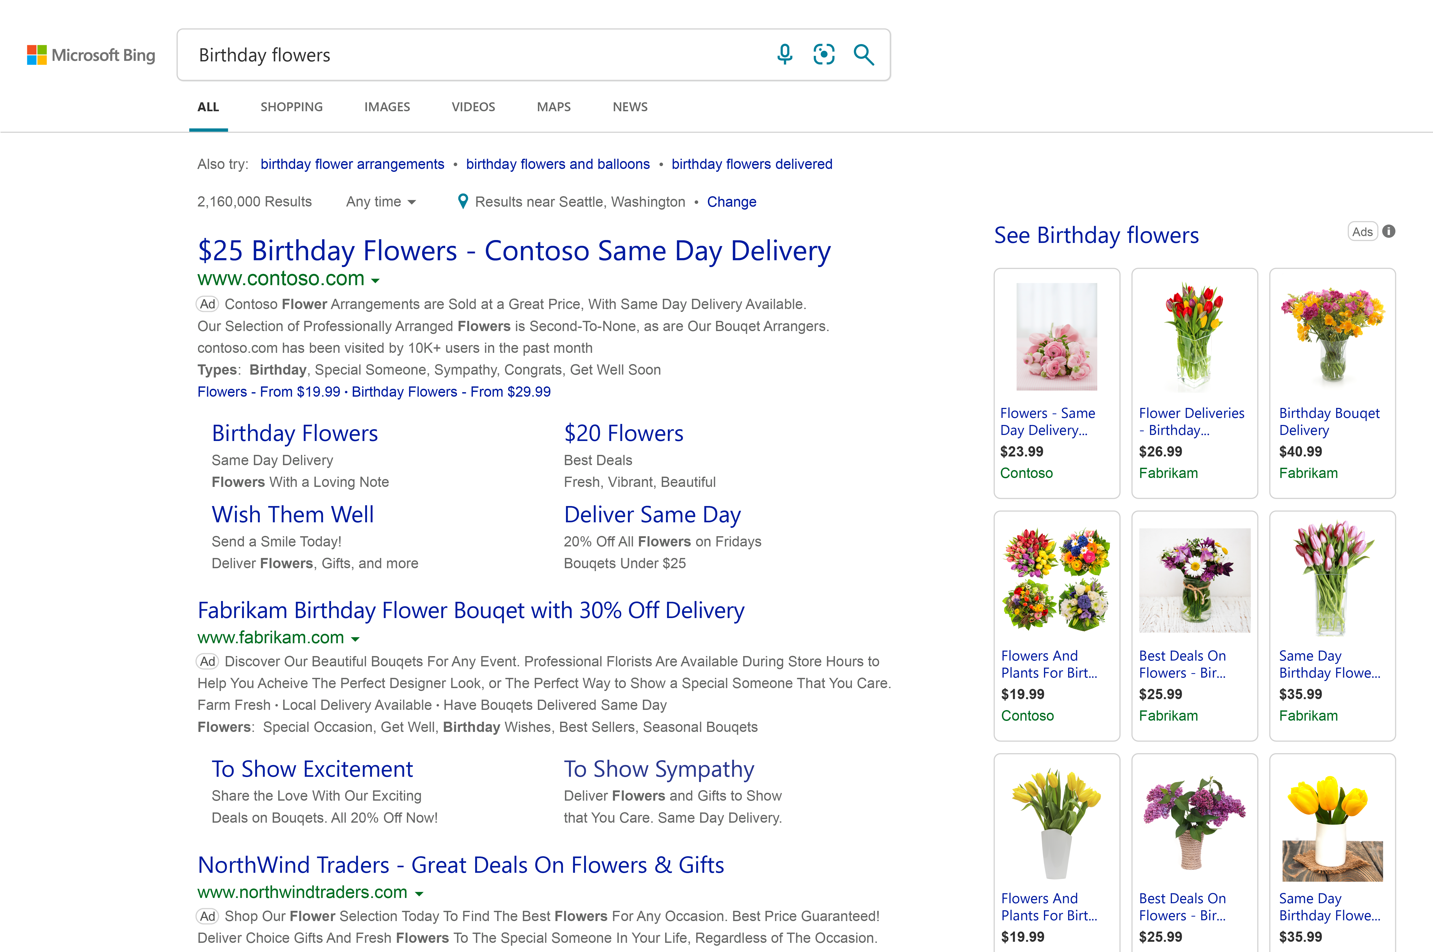
Microsoft Search Network delivers significant traffic where people are in market and ready to buy
689 million monthly PC searchers
14.5 billion monthly PC searches
271 million PC searchers not reached on Google
Source: comScore qSearch, Explicit Core Search (custom), Worldwide, September 2021. Microsoft Search Network includes Microsoft Sites Core Search Explicit, Yahoo Sites Core Search Explicit (searches powered by Bing) and AOL Inc. Core Search Explicit and DuckDuckGo. Data represents PC traffic only.
Notes:
So let’s take a closer look at how we can help. We’ll start with reach and growth.

Slide 6
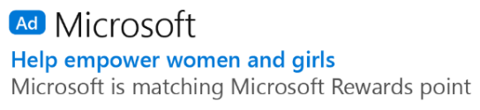
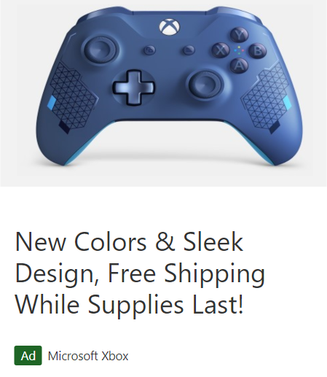
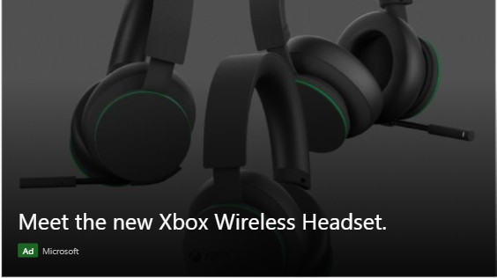
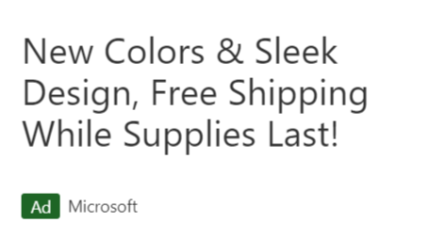
Reach your audience across high-quality brand-safe sites with Microsoft Audience Network
257M
total unique visitors in the U.S.¹
20B
daily cross-screen data signals²
Text ad
Product ad
Image ad
1. comScore Microsoft Audience Platform Report, November 2021. 2. Microsoft internal data.
Notes:
You’re going to find users when they’re searching and also when they’re on our network
The Microsoft Audience Network connects you with millions of potential customers at each stage of the customer decision journey.
We reach over 257 million unique visitors. Our scale over the last two years has significantly risen due to new ad placements on Owned & Operated sites like MSN along with the expansion to premium partner sites.
Your native ads appear in a brand-safe environment on Microsoft​ owned and operated sites like MSN, Outlook.com and Microsoft Edge, and on select premium partner properties like CBS Sports. Third party verification with IAS for brand safety at no extra cost to you.
Today, the Microsoft Audience Network is available in NA (US, CA), APAC (AU, NZ), EMEA (UK, FR, DE, IE, IT, ES, NL, SE, CH, AT, BE, NO, DK, FI), LATAM (AR, BR, CL, CO, MX, PE, VE).​​​
Microsoft Audience Network leverages audience intelligence to identify consumer intent and apply AI to increase your performance and efficiency. Microsoft’s audience intelligence consists of robust privacy-safe consumer data sets, including search and web activity, LinkedIn professional profiles, and demographics and applies machine learning algorithms to develop audiences based on a powerful set of attributes, such as product and brand preferences, purchases and conversions, content preferences, and location.
Our in-feed native ads seamlessly integrate with our reader’s page, mimicking the surrounding of the site design where they’re delivered. Ads that show on the Microsoft Audience Network are called Microsoft Audience Ads and come in three formats: Image Ads, Text Ads and Product Ads.

Slide 7
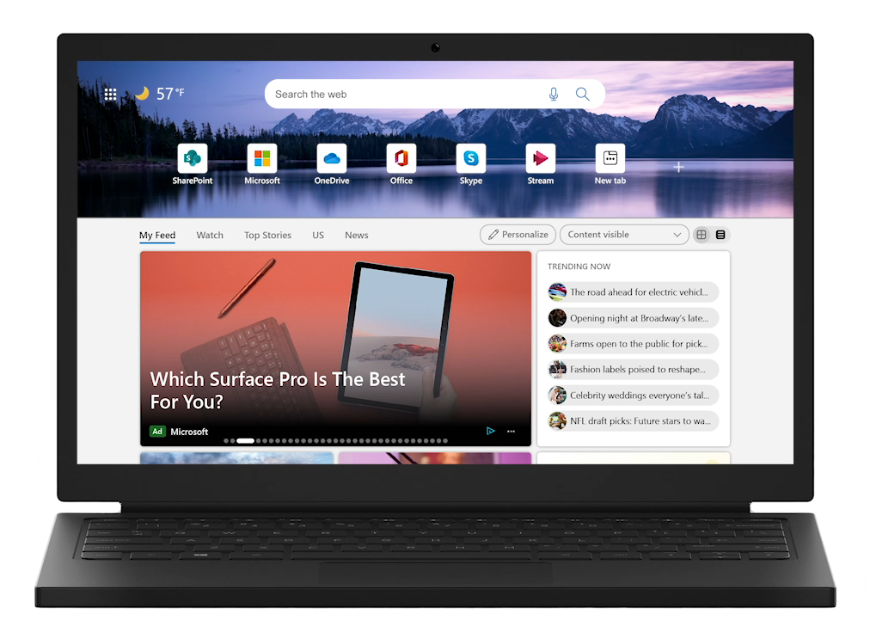
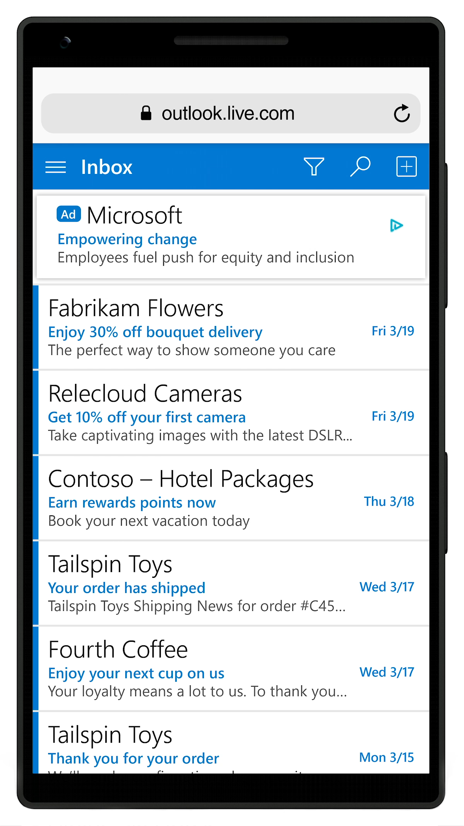
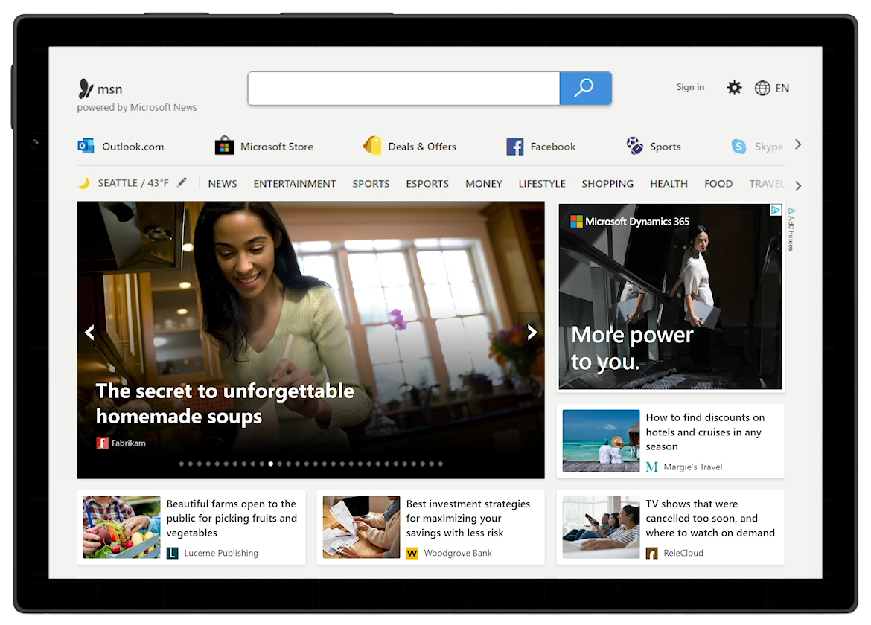
Reach your audience outside of search, across platforms across the consumer decision journey
Microsoft Edge
Microsoft News
Outlook.com
Markets: US, CA, UK, AU, FR, DE, NZ, IE, IT, ES, NL, SE, CH, AT, BE, DK, NO, FI, AR, BR, CL, CO, MX, PE, VE.
Notes:
The Microsoft Audience Network can help you meet consumers at every point in their decision journey, with premium native placements on MSN, Outlook.com, and the Microsoft Edge browser. The Microsoft Audience Network is important piece of your cross-channel strategy.

Slide 8
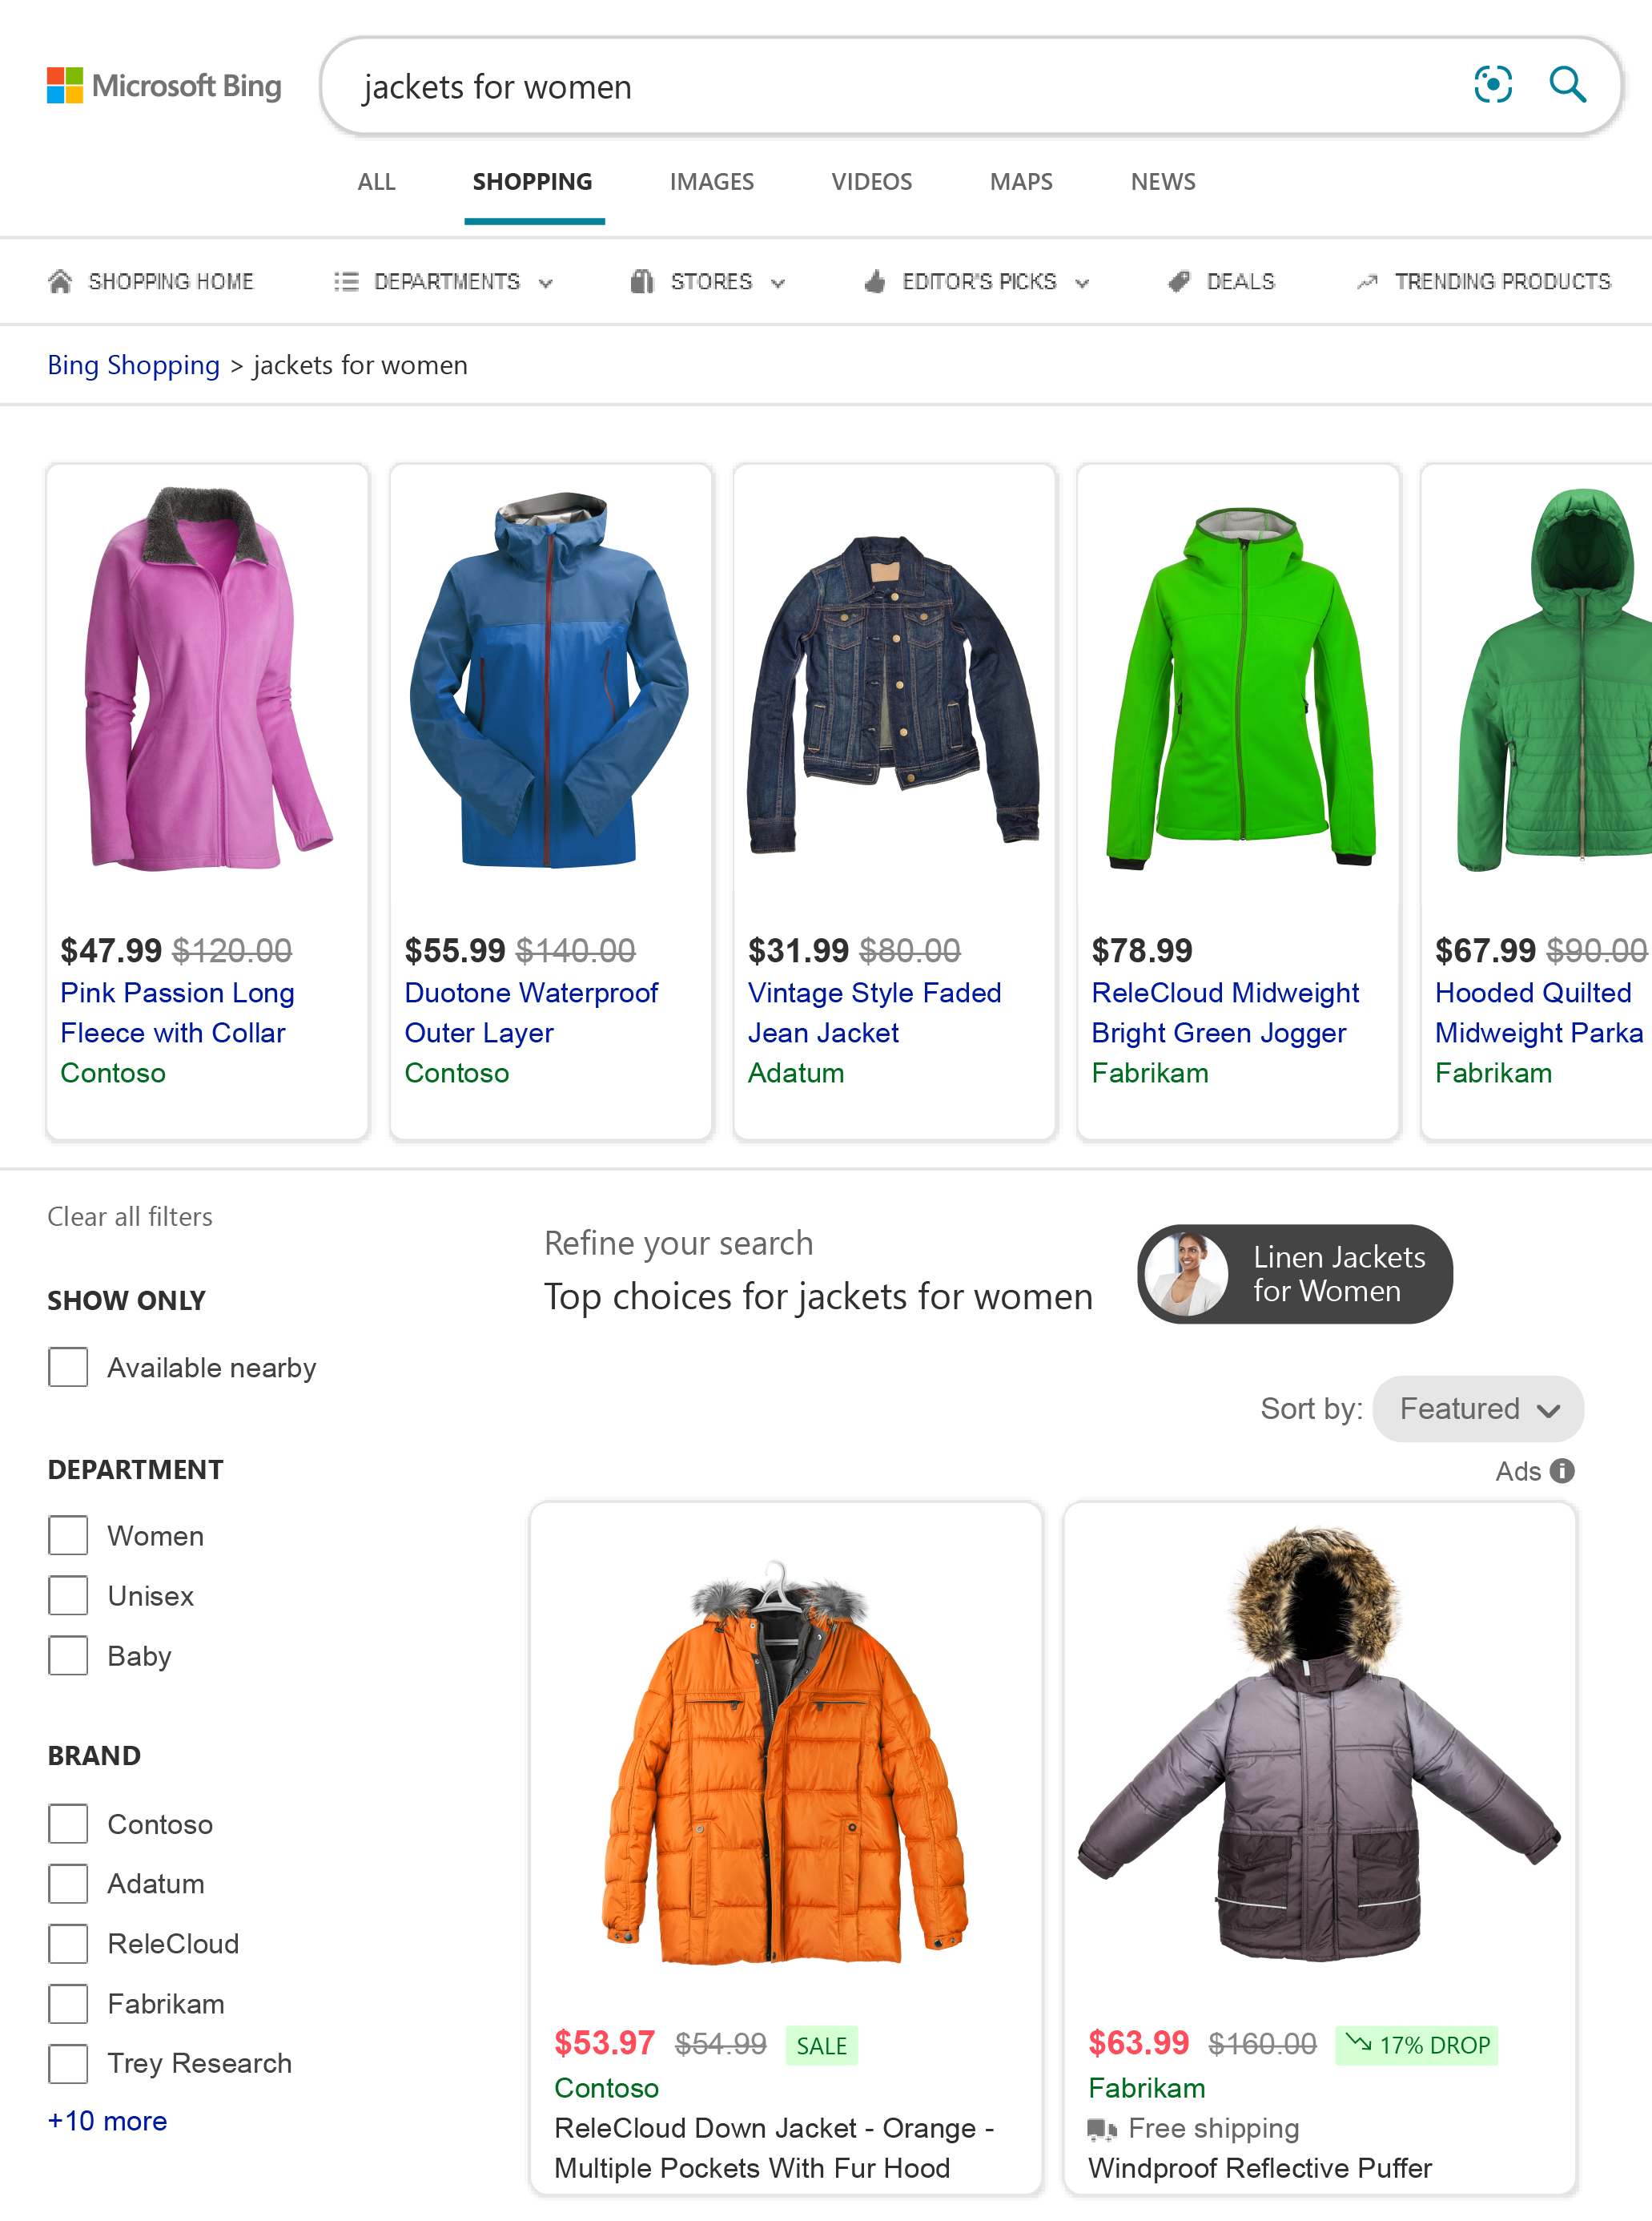
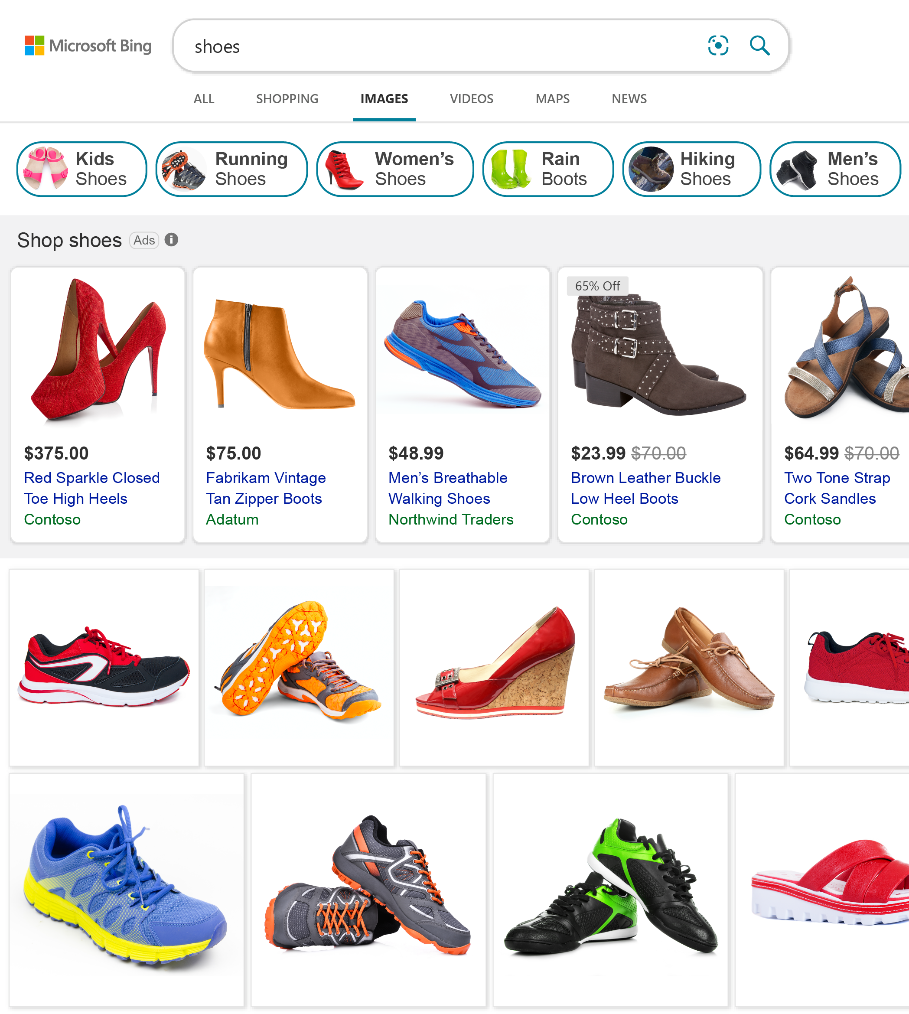
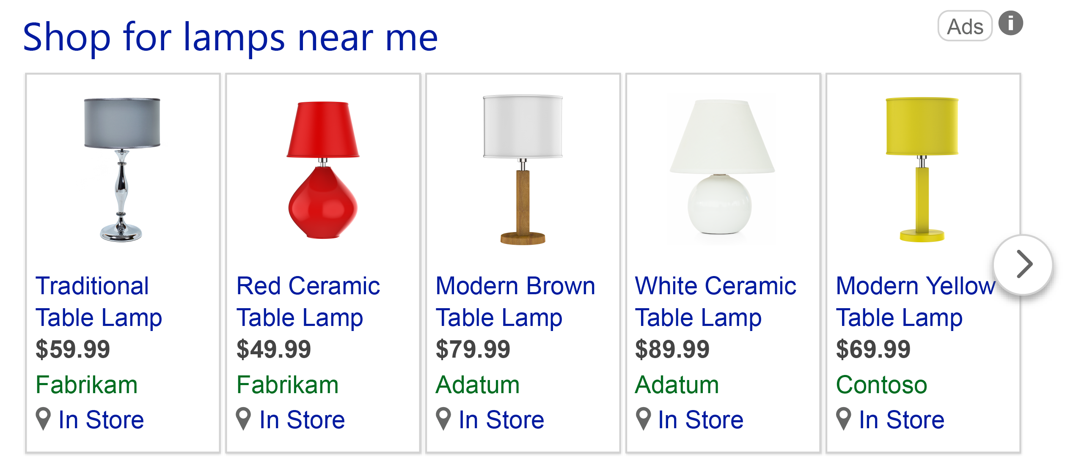
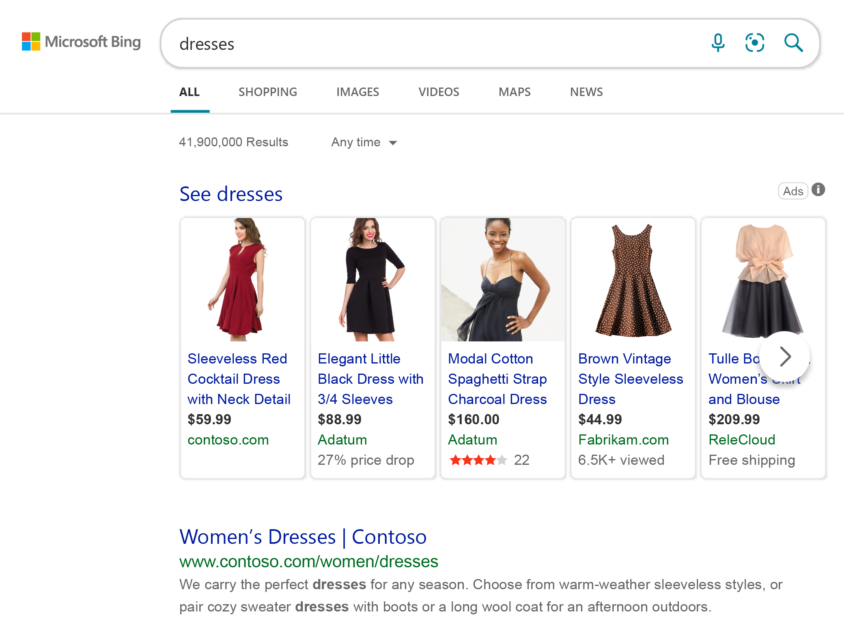
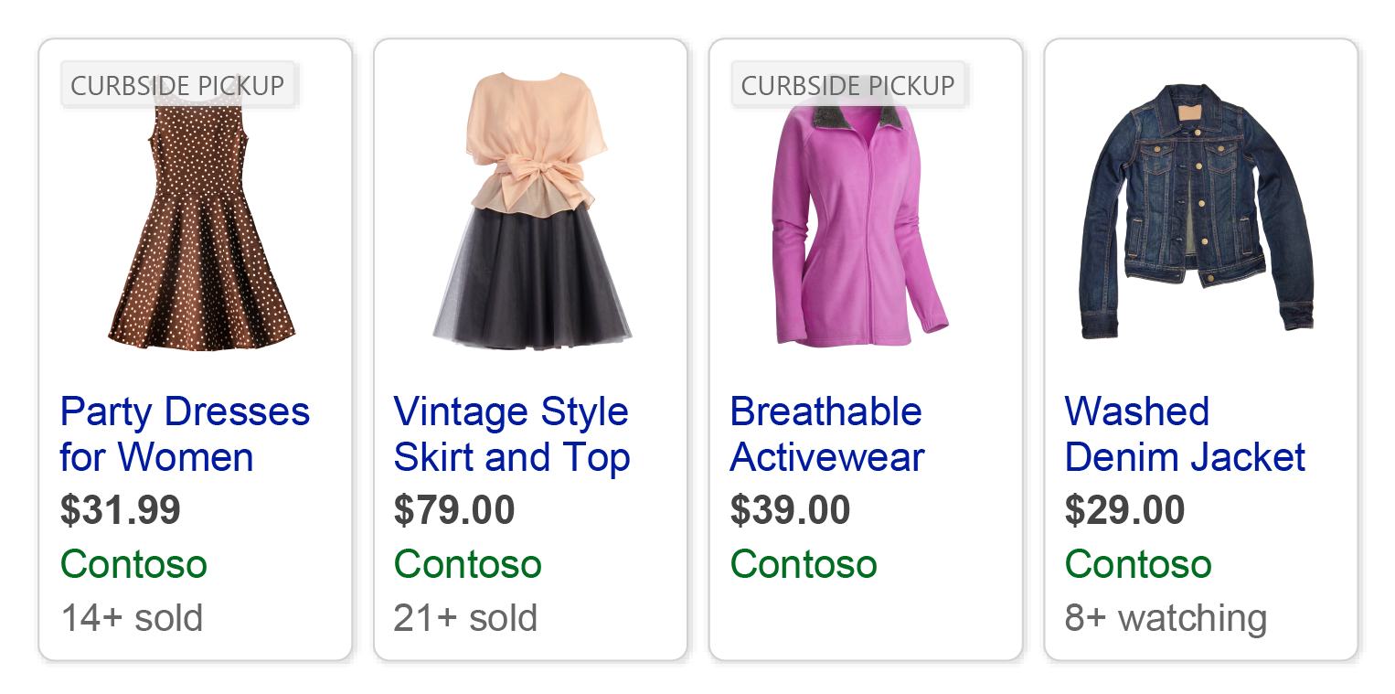
Product Ads experiences
Bridge the gap between your online and in-store experience
Product Ads on Shopping Tab
Product Ads on Images Tab
Local Inventory Ads
Curbside Pickup Badge
Product Ads on Search Page
Notes:
We’re excited to help you reach your customers with a variety of media formats for both search and native, using video and images. Product Ads

Slide 9
Bridge the gap between your online and in-store experience
Product Ads on Shopping Tab
Product Ads on Images Tab
Local Inventory Ads
Curbside Pickup Badge

Slide 10
Bridge the gap between your online and in-store experience
Product Ads on Shopping Tab
Product Ads on Images Tab
Local Inventory Ads
Curbside Pickup Badge

Slide 11
Bridge the gap between your online and in-store experience
Product Ads on Shopping Tab
Product Ads on Images Tab
Local Inventory Ads
Curbside Pickup Badge
Notes:
Showcase your products and local retail store information to nearby shoppers with Local Inventory Ads.
Increase traffic from your Shopping Campaigns Use your retail and online stores to provide a better shopping experience for your shoppers and help increase click-through rates and click volume.
Highlight your brick-and-mortar store locations Local Inventory Ads can help you increase foot traffic and sales in your retail stores.
Promote products that are available in store only Now you can promote products that are available only in stores to nearby shoppers using Local Inventory Ads.

Slide 12
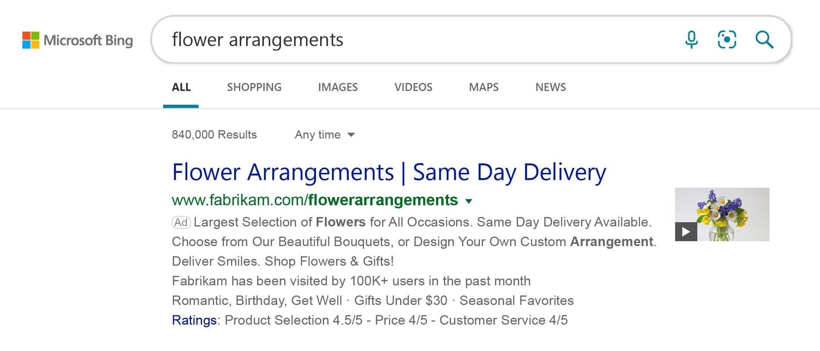
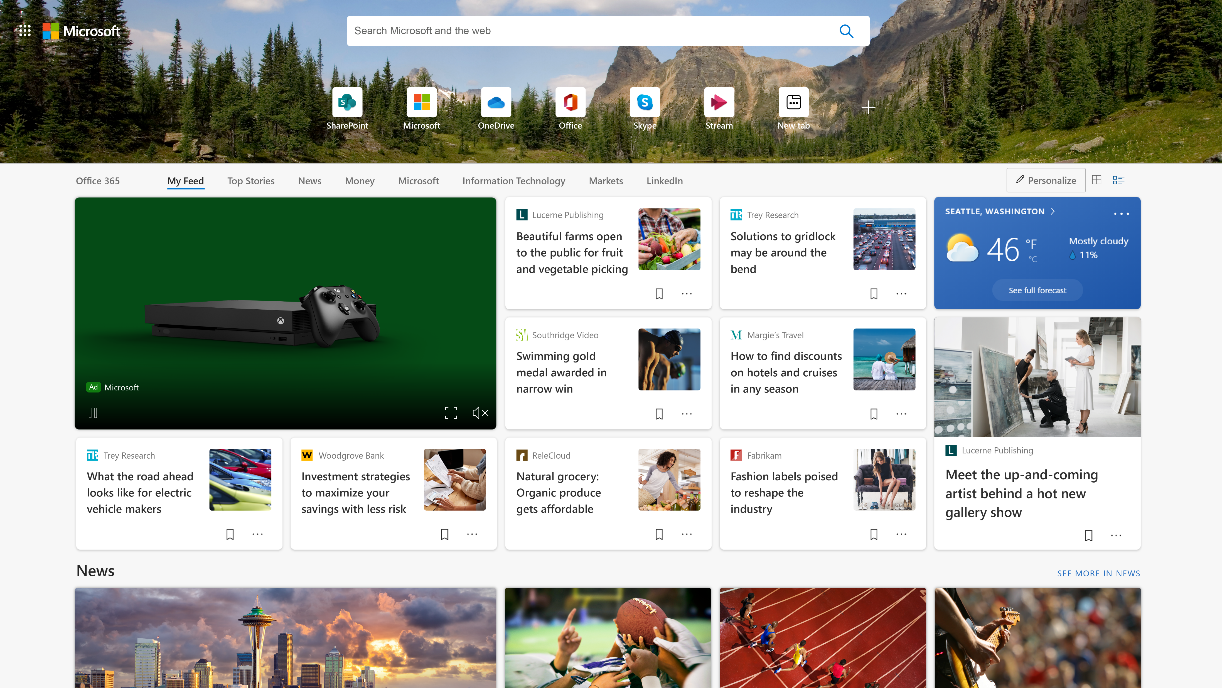
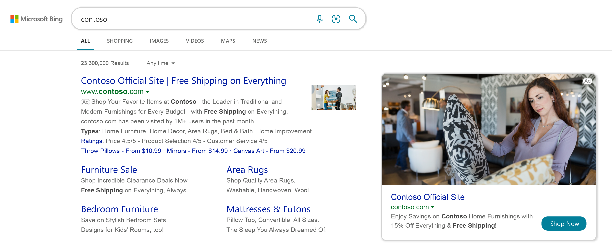

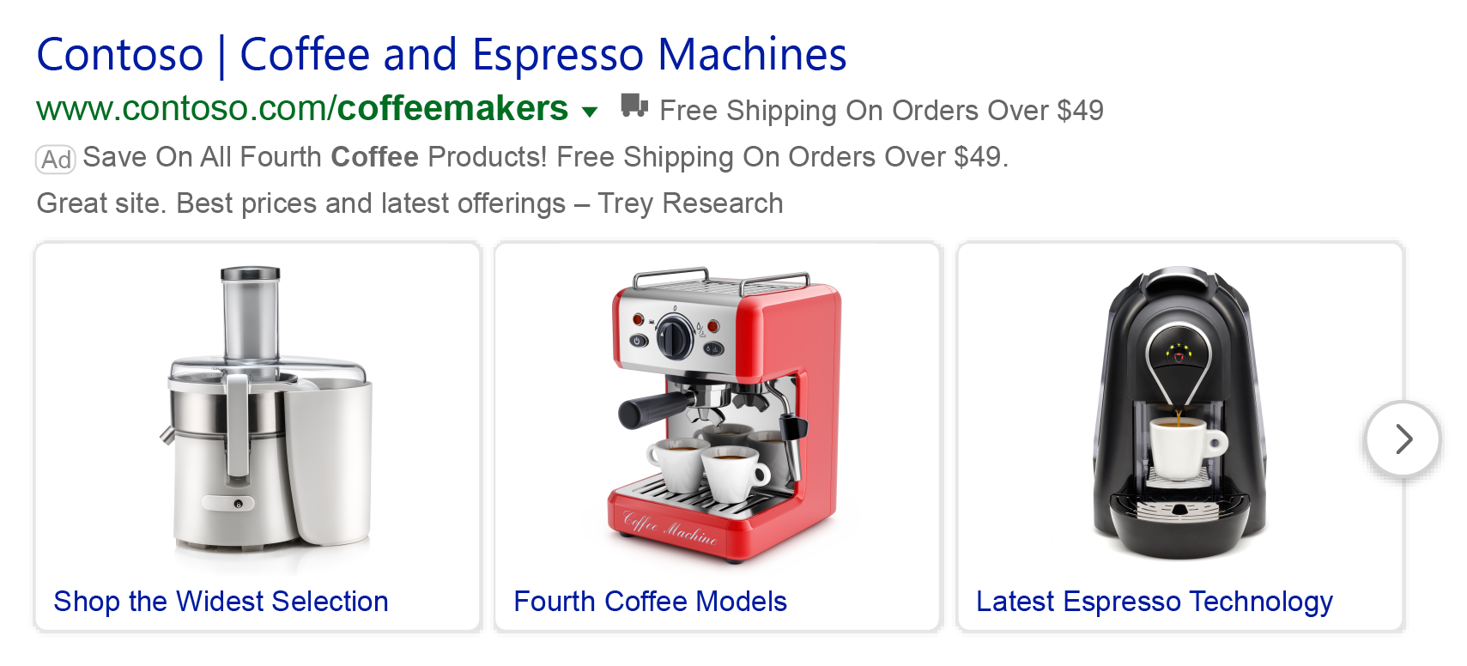
Be visible and influence shoppers’ decisions using rich image-based ads
POWER YOUR
DREAMS
Multi-Image Extensions in search ads
Video Extensions in search ads
Multimedia Ads on search pages
Video Ads on the Microsoft Audience Network
Pre-order a new Xbox console today
0:00 / 0:10
0:01 / 0:10
0:02 / 0:10
0:03 / 0:10
0:04 / 0:10
0:05 / 0:10
0:06 / 0:10
0:07 / 0:10
0:08 / 0:10
0:09 / 0:10
0:10 / 0:10
Notes:
We’re excited to help you reach your customers with a variety of media formats for both search and native, using video and images.
Video Ads (In pilot – US and UK markets, on the Microsoft Audience Network) Video advertising is changing rapidly and more so than ever this past year. Video Ads will be integrated in a page or article where user is most likely to engage with content, to help you reach a highly engaged audience of 300M daily active users who are watching videos. It’s all about bite-sized, short content these days, so videos can be anywhere from 6-120 seconds. For an optimal experience, they will play with sound off. These ads are based on a CPC or CPM model.
Multimedia Ads (Global)
Multi-media Ads are image ads that will serve on the mainline and right rail so you can showcase your brand using images in addition to headlines and descriptions. It’s an exclusive ad space - for a given query only one customer will show up. These ads are created from images you have provided through image extensions. But don’t worry if you don’t have any images – we can suggest a few images for you from the best suited stock images.
Unique to Microsoft Advertising: This is a unique feature that’s not available in Google today.
Video Extensions (Global)
We’re also excited to share that we’re now offering video extensions for both PC and mobile. These videos will be interactive on PC, so make sure to add a “catchy” Call to Action for users.
Unique to Microsoft Advertising: This is a unique feature that’s not available in Google today.

Slide 13





POWER YOUR
DREAMS
Video Extensions in search ads
Multimedia Ads on search pages
Video Ads on the Microsoft Audience Network
Pre-order a new Xbox console today
0:00 / 0:10
0:01 / 0:10
0:02 / 0:10
0:03 / 0:10
0:04 / 0:10
0:05 / 0:10
0:06 / 0:10
0:07 / 0:10
0:08 / 0:10
0:09 / 0:10
0:10 / 0:10
0:00
0:01
0:02
0:03
0:04
0:05
0:06
0:07
0:08
0:09
0:10
Notes:
We’re excited to help you reach your customers with a variety of media formats for both search and native, using video and images.
Video Ads (In pilot – US and UK markets, on the Microsoft Audience Network) Video advertising is changing rapidly and more so than ever this past year. Video Ads will be integrated in a page or article where user is most likely to engage with content, to help you reach a highly engaged audience of 300M daily active users who are watching videos. It’s all about bite-sized, short content these days, so videos can be anywhere from 6-120 seconds. For an optimal experience, they will play with sound off. These ads are based on a CPC or CPM model.
Multimedia Ads (Global)
Multi-media Ads are image ads that will serve on the mainline and right rail so you can showcase your brand using images in addition to headlines and descriptions. It’s an exclusive ad space - for a given query only one customer will show up. These ads are created from images you have provided through image extensions. But don’t worry if you don’t have any images – we can suggest a few images for you from the best suited stock images.
Unique to Microsoft Advertising: This is a unique feature that’s not available in Google today.
Video Extensions (Global)
We’re also excited to share that we’re now offering video extensions for both PC and mobile. These videos will be interactive on PC, so make sure to add a “catchy” Call to Action for users.
Unique to Microsoft Advertising: This is a unique feature that’s not available in Google today.

Slide 14
POWER YOUR
DREAMS
Video Extensions in search ads
Multimedia Ads on search pages
Video Ads on the Microsoft Audience Network
Pre-order a new Xbox console today
0:00 / 0:10
0:01 / 0:10
0:02 / 0:10
0:03 / 0:10
0:04 / 0:10
0:05 / 0:10
0:06 / 0:10
0:07 / 0:10
0:08 / 0:10
0:09 / 0:10
0:10 / 0:10
0:10
Notes:
We’re excited to help you reach your customers with a variety of media formats for both search and native, using video and images.
Video Ads (In pilot – US and UK markets, on the Microsoft Audience Network) Video advertising is changing rapidly and more so than ever this past year. Video Ads will be integrated in a page or article where user is most likely to engage with content, to help you reach a highly engaged audience of 300M daily active users who are watching videos. It’s all about bite-sized, short content these days, so videos can be anywhere from 6-120 seconds. For an optimal experience, they will play with sound off. These ads are based on a CPC or CPM model.
Multimedia Ads (Global)
Multi-media Ads are image ads that will serve on the mainline and right rail so you can showcase your brand using images in addition to headlines and descriptions. It’s an exclusive ad space - for a given query only one customer will show up. These ads are created from images you have provided through image extensions. But don’t worry if you don’t have any images – we can suggest a few images for you from the best suited stock images.
Unique to Microsoft Advertising: This is a unique feature that’s not available in Google today.
Video Extensions (Global)
We’re also excited to share that we’re now offering video extensions for both PC and mobile. These videos will be interactive on PC, so make sure to add a “catchy” Call to Action for users.
Unique to Microsoft Advertising: This is a unique feature that’s not available in Google today.

Slide 15

POWER YOUR
POWER YOUR
DREAMS
DREAMS
Video Extensions in search ads
Multimedia Ads on search pages
Video Ads on the Microsoft Audience Network
Video Ads on the Microsoft Audience Network
Pre-order a new Xbox console today
Pre-order a new Xbox console today
0:00 / 0:10
0:01 / 0:10
0:02 / 0:10
0:03 / 0:10
0:04 / 0:10
0:05 / 0:10
0:06 / 0:10
0:07 / 0:10
0:08 / 0:10
0:09 / 0:10
0:10 / 0:10
0:00 / 0:10
0:01 / 0:10
0:02 / 0:10
0:03 / 0:10
0:04 / 0:10
0:05 / 0:10
0:06 / 0:10
0:07 / 0:10
0:08 / 0:10
0:09 / 0:10
0:10 / 0:10
Notes:
We’re excited to help you reach your customers with a variety of media formats for both search and native, using video and images.
Video Ads (In pilot – US and UK markets, on the Microsoft Audience Network) Video advertising is changing rapidly and more so than ever this past year. Video Ads will be integrated in a page or article where user is most likely to engage with content, to help you reach a highly engaged audience of 300M daily active users who are watching videos. It’s all about bite-sized, short content these days, so videos can be anywhere from 6-120 seconds. For an optimal experience, they will play with sound off. These ads are based on a CPC or CPM model.
Multimedia Ads (Global)
Multi-media Ads are image ads that will serve on the mainline and right rail so you can showcase your brand using images in addition to headlines and descriptions. It’s an exclusive ad space - for a given query only one customer will show up. These ads are created from images you have provided through image extensions. But don’t worry if you don’t have any images – we can suggest a few images for you from the best suited stock images.
Unique to Microsoft Advertising: This is a unique feature that’s not available in Google today.
Video Extensions (Global)
We’re also excited to share that we’re now offering video extensions for both PC and mobile. These videos will be interactive on PC, so make sure to add a “catchy” Call to Action for users.
Unique to Microsoft Advertising: This is a unique feature that’s not available in Google today.

Slide 16
Find your target audience with our suite of audience targeting dimensions
User and intent targeting
User profile targeting
Location and device
Remarketing
In-market
Audiences
Custom
Audiences
Dynamic Remarketing
LinkedIn Profile Targeting¹
Location targeting
Similar Audiences
Customer Match
Custom Combination Lists
Age and gender targeting
Device targeting
1. Three LinkedIn profile dimensions available: Industry, company and job function.
Notes:
Microsoft Advertising has audience targeting options available for everyone – whether you bring the data or we bring the data, you create the audience list or Microsoft Advertising creates the audience list, or whether you’ve tagged your website or not., there’s an option for everyone
We offer basic targeting features to more advanced targeting based on Microsoft’s audience intelligence which consists of robust privacy-safe consumer data sets, including search and web activity, LinkedIn professional profiles, and demographics and applies machine learning algorithms to develop audiences based on a powerful set of attributes, such as product and brand preferences, purchases and conversions, content preferences, and location.
Remarketing: Allows you to reengage with audiences that have previously visited your site – another chance to influence users to convert.
In-market Audiences – AI-powered feature – Microsoft Advertising does the heavy lifting for you, building hundreds of lists of people in-market and ready to buy – you can be up and running in <5 minutes.
Custom Audiences: Is a type of remarketing list that’s generated by using your own customer data, usually managed by a data management platform (DMP) to create richer segments. No one knows more about your customers than you!
Similar Audiences (aka “Lookalikes”) are audience lists that Microsoft Advertising builds, modeled after the Remarketing lists you’ve created. These can help you connect with additional users who are similar to those in your Remarketing lists.
Dynamic Remarketing: Take your feed-based campaigns to the next level with product-specific remarketing. Dynamic Remarketing targets users based on specific product IDs they’ve interacted with to show users ads with the same product IDs.
Customer Match: With Customer Match, use the email addresses your customers have shared with you to reengage with them across the Microsoft Search Network and Microsoft Audience Network.
Custom Combination Lists: Create and reach the right audience by simply combining your existing audience lists, using AND, OR and NOT. (Note: You can’t create lists using In-market Audiences or LinkedIn Profile Targeting)
Unique to Microsoft Search Network is LinkedIn Profile Targeting – Target users based on their company, industry or job function. (Ads show up on the Microsoft Search Network SERP (search engine results page) or on the Microsoft Audience Network; not on LinkedIn feed.) We’re the only ad platform (outside of LinkedIn) to offer LinkedIn Profile Targeting.

Slide 17
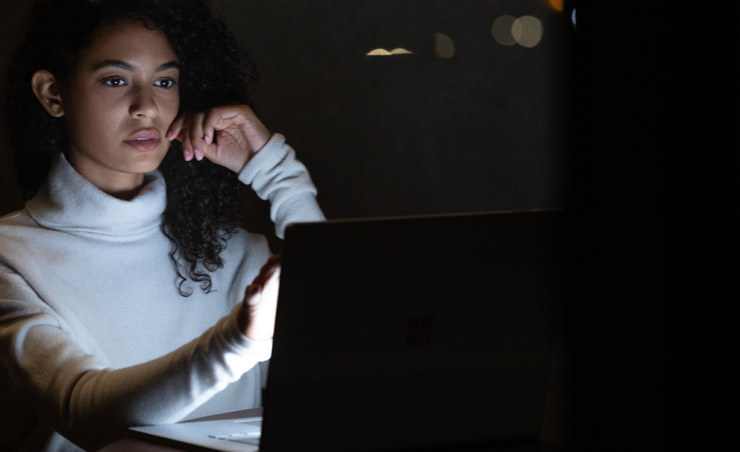
Microsoft Advertising integration with Dynamics 365 Customer Insights
Access rich, unified first-party data
Targeting first-party audiences can help boost performance. As cookies are phased out, first-party data will become even more of a priority for delivering personalized advertising experiences.
EasIly manage customer segments
Access and manage your most up-to-date audience segments all in one place, making it easy to share to many destinations, including Microsoft Advertising.
Scale efficiently across ad Platforms
Create a unified and consistent audience approach across ad platforms, including Microsoft Advertising, to make targeting your most valuable customers easier.
Bring your customer segments from Dynamics 365 Customer Insights into Microsoft Advertising to target with Customer Match.
Notes:
As we know that CDP’s have gone from a nice-to-have to a must-have with the deprecation of 3P cookies, we recently announced an integration with Dynamics 365 Customer Insights. With this integration you can bring your customer segments from Dynamics 365 Customer Insights into Microsoft Advertising to reach with Customer Match targeting.
If you are not actively locked into a CDP platform today. The Microsoft Dynamics 365 Customer Insights solution has the capabilities to help organizations like yours better manage your customer data:
It provides you a complete view of your customers. Organizations can combine and enrich their data in real-time, and it’s important to note that much of this work can be done by business users without writing any code.
You can unlock powerful insights with limitless analytics. AI insights are provided out-of-the-box for business users, and the solution scales to support the most demanding data workloads for data professionals. The result is virtually limitless analytics capabilities.
It’s also critical to take the insights generated by analytics and translate them into concrete business decisions and actions, which is all built into the product. The solution both integrates with Dynamics 365 and 3rd party systems to ensure that insights become actions, and it also triggers automated workflows based on customer actions and predictive analytics.
And it’s all built on a trusted platform with unmatched security and privacy
Learn more about Microsoft Dynamics 365 Customer Insights: Biz Apps Hub (microsoft.com)

Slide 18

Trusted, open digital platform
Privacy
and
personalization
Notes:
Core to our principles in how we operate and create value for your brand and business is through trust.
Microsoft operates on a foundation of trust—it always has.
Today there is an increasing dependency on technology partners for you to understand and reach your own customers.
We are championing an ecosystem that benefits all players, where privacy and personalization are not on opposite ends of the spectrum.
As digital profiles fragment with upcoming 3rd party cookie deprecation, mobile ID loss and regulatory changes, we are helping marketers connect with the audiences they desire through our global advertising and data platform services powered by Microsoft audience intelligence
To combat threats of fragmentation and help marketers navigate the identity environment, we are continuing to build out a robust global 1st party identity-based advertising network. We are continuing our work on a common log-in across Microsoft, strengthening our addressable audiences
We are allowing for co-mingling of our data with your customer data in a privacy centric way through Customer Match. All while not losing sight of consumer transparency, control and trust.
We can give you full control over your data and allow you to enrich it to best serve your needs – not ours. For example, our CDP, Dynamics Customer Insights, offers marketers an easy way to export their target audiences into Microsoft Advertising for activation, in addition to many other marketing and advertising services.
We are working with the industry, including Google, on a solution to the deprecation of 3P cookies called PARAKEET, which is more friendly to the existing advertising ecosystem, meaning that advertisers can still use their partners (such as DSPs and DMPs), minimizing disruption to their current operations.

Slide 19

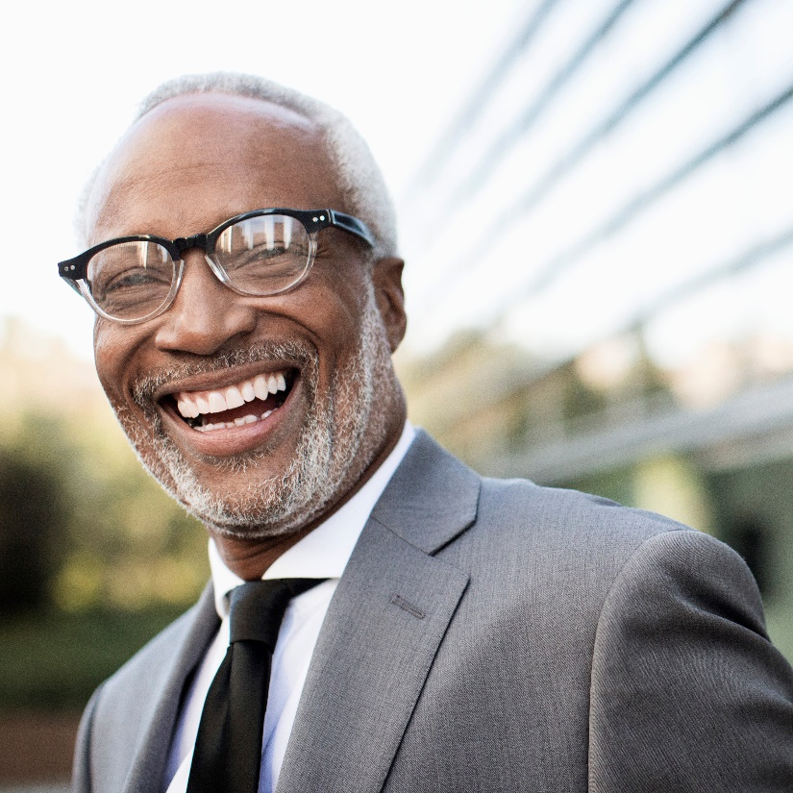




Marketing with Purpose
85% of people say they’ll only consider a brand if they trust the brand.
LOYALTY
Brand love
Brand trust
1. The Acceleration of Brand Performance Through Trust, Love, and Loyalty. Microsoft Advertising Research 2019.
Notes:
Whether or not a consumer trusts a brand and sees it as inclusive, authentic, and purposeful can mean the difference between choosing that brand over another—or not choosing it at all.
Brands that build from a foundation of trust and lead with purpose to create more authentic engagements gain more of what’s truly invaluable: brand love and customer loyalty. As trust in a brand increases so does brand love leading to every brand’s goal of customer loyalty and advocacy.
Microsoft Advertising pioneered a set of research studies on the importance of trust and inclusion to brand and advertising performance. These studies formed the foundation of our Marketing with Purpose initiative of educating clients, partners and the industry on responsible business practices, leading with your values to create value, and being a more inclusive advertiser. The result of that work is a playbook and a marketing with purpose course that we have delivered to our clients to help them in their ‘purpose-led’ journey.
Purpose is infused in everything we do for our clients and we will continue to lead marketing with purpose as an important initiative with insights, examples and training that help their brands build customer trust.
Please point your clients to: MicrosoftAdvertising.com/marketingwithpurpose where they can take the course and download the playbook.

Slide 20
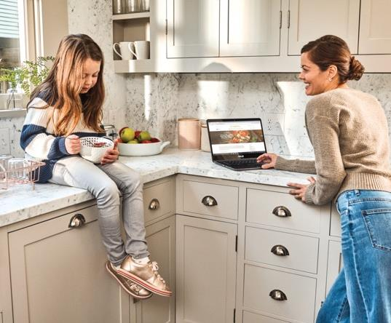
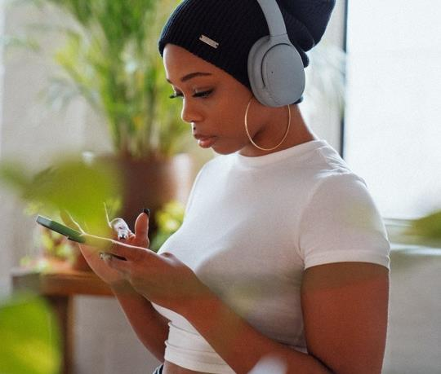
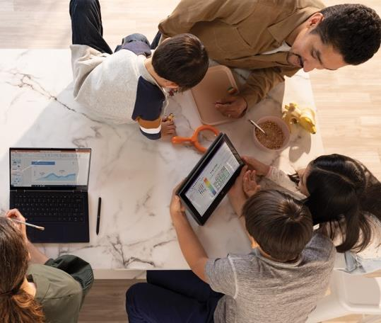
Getting more value out of every interaction with Microsoft Advertising
Relevant
reach
Intelligent experiences
Trusted and open digital platform
Notes:
One thing is clear: doing things the old way is no longer an option. Growing your business requires a new way of thinking about how to reach people when, where, and how they want to engage. It requires accelerating your digital strategy to deliver authentic brand experiences.
Across Microsoft devices and services that people rely on every day across work and life, you gain access to a diverse, global, high-value audience. And we deliver audience intelligence that helps you pinpoint your ideal customer and deliver more relevant messages based on audience intent across the entire customer journey.
It’s not just about connecting with audiences. It’s also about building trust. The trust consumers have in brand-safe spaces translates into greater willingness to try and transact with your brand.
Our approach to partnership is about providing multi-channel solutions that allow you to leverage your most valuable assets like your data to improve your bottom line — not ours.

Slide 21


CASE STUDY
Results
The company maximized its online reach with Microsoft Advertising search partners, Dynamic Search Ads and the Microsoft Audience Network, gaining a 70% increase in click volume.
With the growing interest in home improvement projects, U.S. e-commerce retailer Build with Ferguson sought to meet changing consumer behavior.

Slide 22
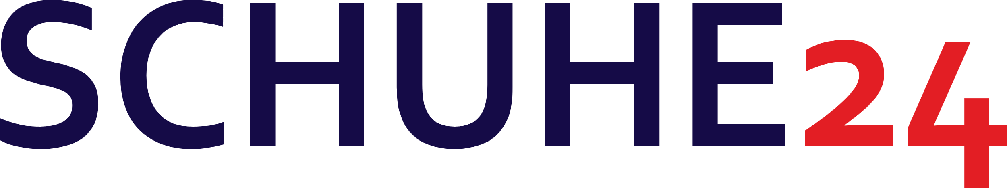

CASE STUDY
Results
By using the Microsoft Audience Network with Remarketing and In-market Audiences, Schuhe24 achieved a 15% increase in clicks and a 50% lower cost per acquisition.
A leading e-commerce platform for shoe and fashion retailers in Europe, Schuhe24 wanted to increase brand awareness and recognition in a highly competitive industry.

Slide 23


CASE STUDY
Results
With Shopping Campaigns and other Microsoft Advertising offerings, the company saw a 2x increase in the number of visitors and a 4x ROI during festivals and occasions.
A florist chain in India with 50,000 gifting choices, Ferns N Petals wanted to provide continued services despite the pandemic.

Slide 24


CASE STUDY
Results
With a Microsoft Audience Network campaign that uses Product Ads and Dynamic Remarketing targeting, L.L.Bean achieved a 25% lower cost per click, 41% lower cost per acquisition and 52% higher return on ad spend.
L.L.Bean, a U.S. retail company that specializes in clothing and outdoor recreation equipment, wanted to reach consumers throughout the entire marketing funnel.

Slide 25
End slide
MicrosoftAdvertising.com

